Slide 1


Automata for Digital Signatures
Hardware-based automata provide efficient and secure solutions for digital signature verification. This PPT explores design principles, implementation challenges, and performance optimizations for embedded systems.

Slide 2


Digital Signatures and Hardware Verification
This slide covers the essentials of digital signatures, their verification using finite-state automata, and the superior performance of dedicated hardware solutions like ASIC/FPGA in secure communications.
Digital Signature Basics
Digital signatures ensure data integrity and authentication using cryptographic algorithms like RSA or ECC, widely adopted in secure communications.
Automata in Verification
Finite-state automata (FSA) model signature verification steps, enabling deterministic and parallelizable hardware implementations.
Hardware Advantages
Dedicated hardware (ASIC/FPGA) offers lower latency, higher throughput, and resistance to software-based attacks compared to software solutions.

Slide 3


Design Principles
1
State Machine Architecture
2
Parallel Processing
Exploiting hardware parallelism accelerates modular arithmetic operations (e.g., exponentiation) critical for signature schemes.
FSAs are structured into states (e.g., key loading, hashing, verification) with transitions triggered by input data or clock cycles.
3
Memory Optimization
4
Error Handling
Built-in fault detection (e.g., CRC checks) ensures robustness against hardware faults or adversarial tampering.
On-chip RAM/ROM stores precomputed constants (e.g., hash tables) to reduce latency and power consumption.

Slide 4




Implementation Challenges
Resource Constraints
Timing Synchronization
Limited FPGA logic cells or ASIC area demand compact automata designs with minimal state redundancy.
Clock domain crossing and pipelining must align with cryptographic operations to prevent race conditions.
1
2
Standard Compliance
Side-Channel Resistance
4
3
Adherence to NIST FIPS 186-5 or IEEE P1363 ensures interoperability with existing signature protocols.
Power/EM shielding techniques (e.g., masking) mitigate leakage of sensitive key material during verification.

Slide 5
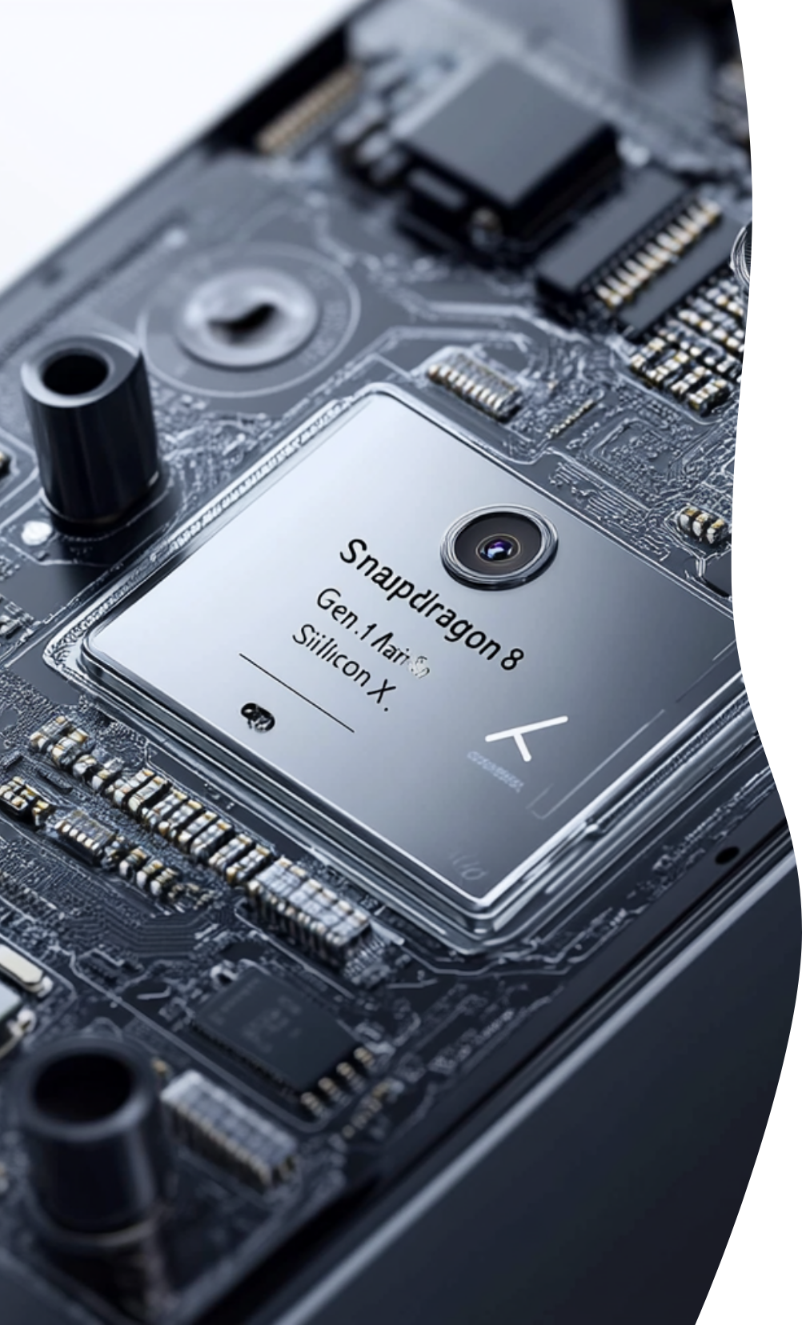


Performance Metrics
Throughput
Latency
Measured in signatures/second, influenced by clock frequency and parallel execution units (e.g., 10K ops/sec @ 200MHz).
End-to-end verification time (e.g., 50µs for RSA-2048) depends on critical path optimization.
Power Efficiency
Area Utilization
mW/signature metric vital for IoT/edge devices; dynamic clock gating reduces idle power.
FPGA LUT/register usage or ASIC gate count determines scalability (e.g., 15K gates for ECDSA-256).

Slide 6



Case Studies in Hardware Acceleration and Post-Quantum Cryptography
ASIC for RSA Encryption
2
7nm ASIC prototypes reach 20Gbps throughput using systolic array multipliers.
FPGA-Based ECDSA Implementation
1
Xilinx Zynq implementations achieve 8x speedup over software with 2.5W power draw.
Post-Quantum Cryptography Preparation
3
Lattice-based automata designs (e.g., Dilithium) show 40% area overhead vs. classical schemes.

Slide 7



Future Directions
Quantum Resistance
AI Co-Design
3D-IC Integration
Automata redesign for lattice/hash-based signatures to replace vulnerable RSA/ECC.
ML-driven state pruning reduces hardware footprint while maintaining verification accuracy.
Vertical stacking of memory and logic layers enhances performance-per-watt.

Slide 8



Conclusion
Adoption Barriers
2
High NRE costs and standardization gaps hinder widespread deployment.
Key Takeaways
Hardware automata enable fast, secure, and energy-efficient signature verification for modern cryptography.
1
Call to Action
Collaborate across academia/industry to bridge theory and practical hardware optimizations.
3

